Slide 1
Chemical Formulas

Slide 2
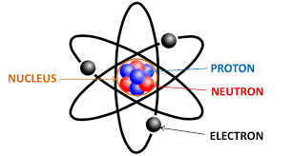
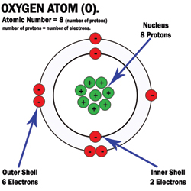
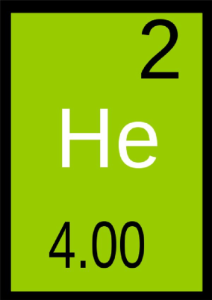
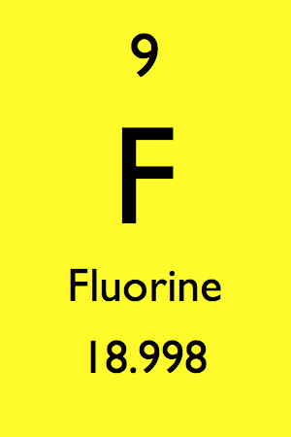
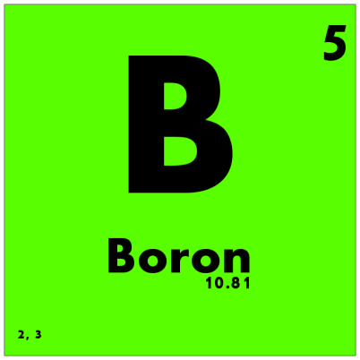
Atoms are the basic units of matter. Atoms join together chemically to form molecules.
Elements are pure substances.
Elements are represented by 1-2 letters called symbols on the Periodic Table.

Slide 3
Elements and Molecules
Elements are pure substances made from atoms of that element.
- Examples: P and Mg
Molecule is a term used to refer to 2 or more atoms which are chemically bonded together.
-Examples: O2 and CO2

Slide 4
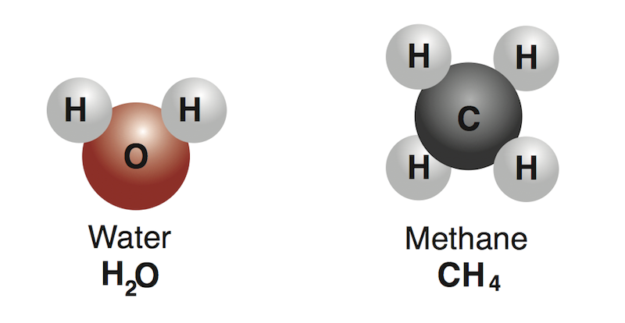
Compounds
Compounds are substances made of two or more different elements chemically combined in a set ratio.
A chemical bond, or electric force holds the atoms together in a compound.
CO2 is both a molecule and a compound as well.

Slide 5
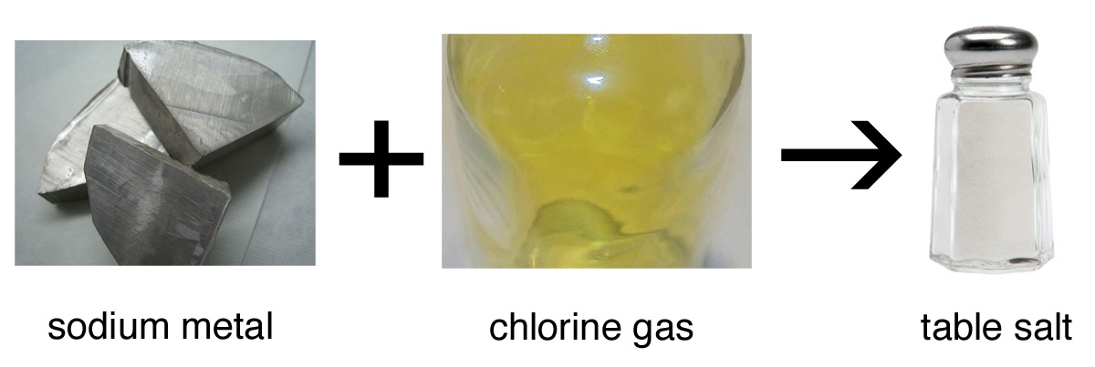
Compounds
The properties of a compound are usually different from the elements that make up the compound.
For example
Salt is composed of sodium (Na); a silvery metal; and chlorine (Cl); a stinky green gas
When they bond to form NaCl, they form solid white crystals which you can eat!

Slide 6
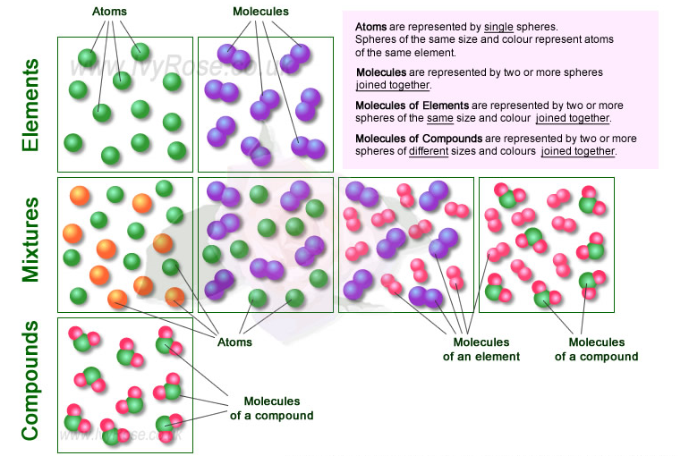

Slide 7
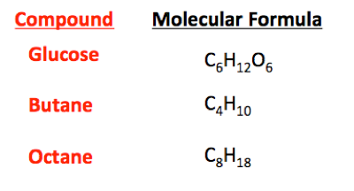
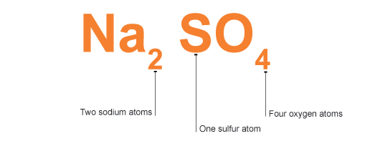
Chemical Formulas- Symbolic representation of a chemical compound.
Chemical formulas are used to identify substances and determine the number of atoms of each element.
The elements present in a compound are identified with the element’s symbol.

Slide 8
Subscripts
Small numbers behind the element or compound
Shows the number of atoms in each substance.
NH₃
NaCl
H₂O₂
Coefficients
Numbers in front of the chemical formula
Shows the number of molecules
2NH₃
3NaCl
4H₂O₂

Slide 9
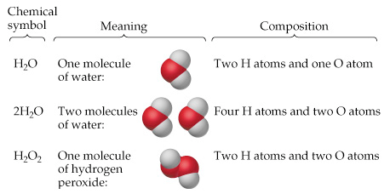
2SO3
What are the elements in the compound?
How many atoms are in the compound?
How many molecules of the compound are there?

Slide 10
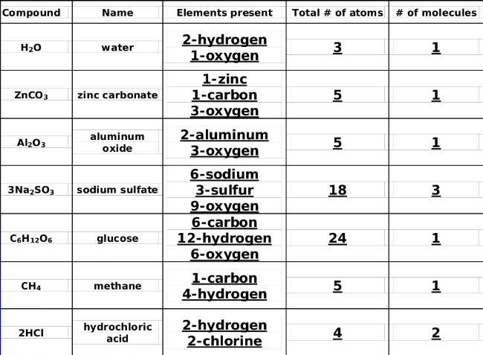

Slide 11
Practice
NaOH
MgCl₂
2NaOH
NaC₂H₃O₂

